Slide 1

First Iterations
LSR – Tiger Takeoff
Team 2 – Matthew G, Caleb D, Ian K, Michael U, John C, Krista L, Michael F, Achuil C

Slide 2
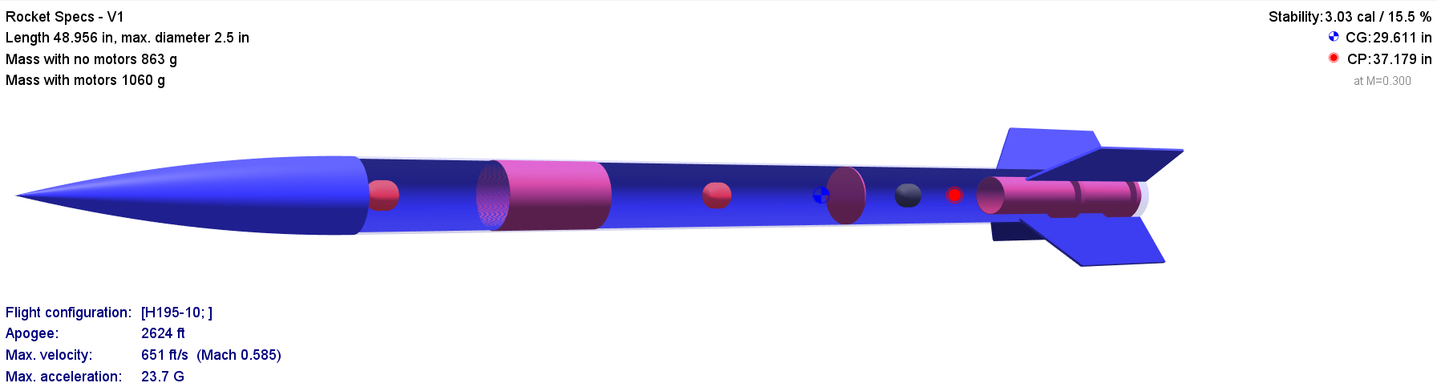
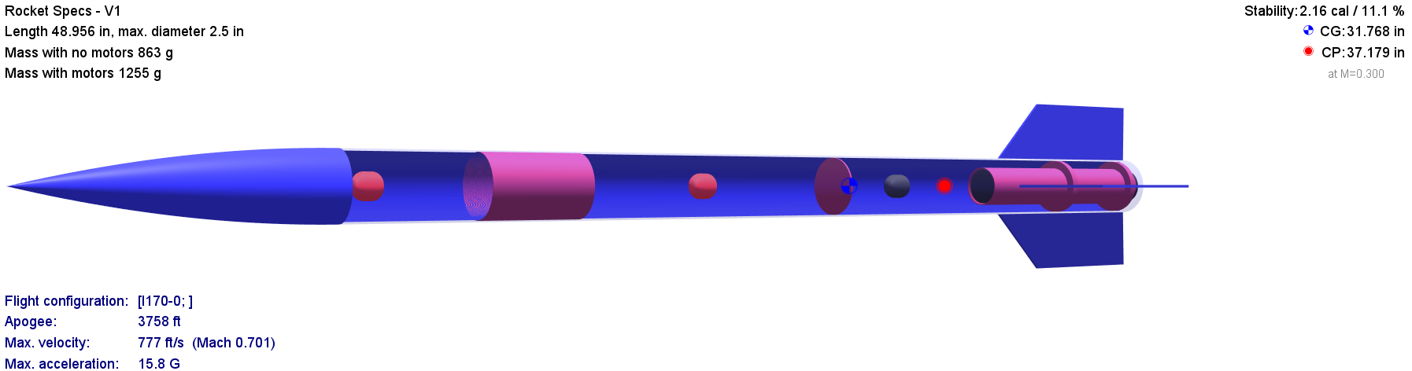
Constraints:
Flight Simulation:
Ground Hit Velocity
Drogue Parachute vs Main Parachute
Weight of Rocket
Length/Volume of Rocket
Stability b/w 1-5
Aerotech – H 195 – D 1.14 in
Cesaroni – I 170 – D 1.5 in

Slide 3
Design concepts

Slide 4
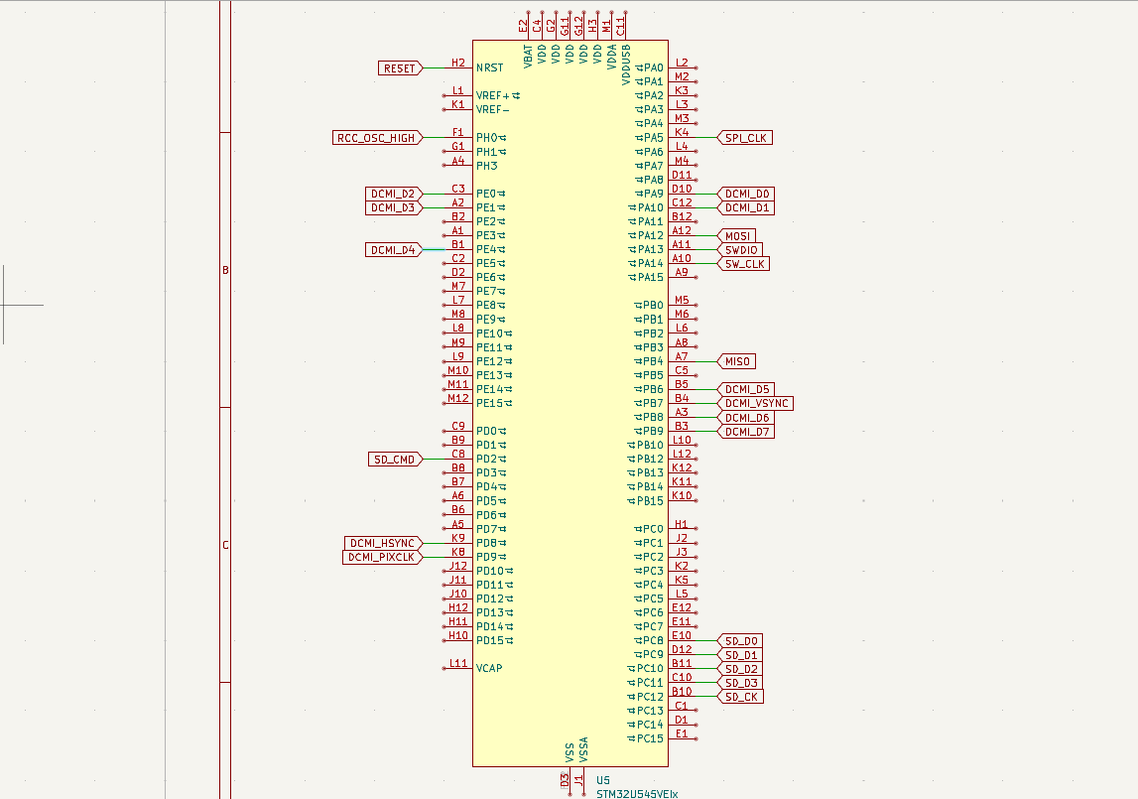
Electronic PCB Schematic
(MCU)

Slide 5
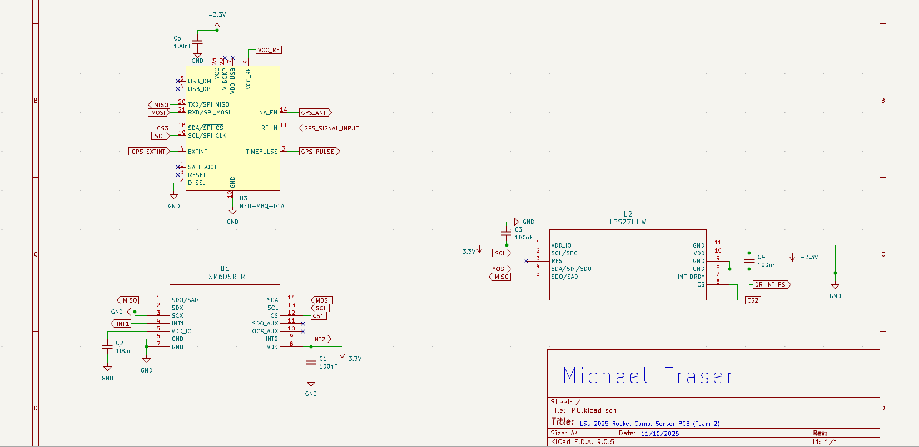
Electronic PCB Schematic
(Sensors)

